Slide 1
CSCIU 310 01 Introduction to Computer Architecture AKM Jahangir A Majumder, PhD
Spring 2019 - Lecture 4
January 28, 2019
Note: Some slides are adapted from those used by previous instructors and some slides include figures from the textbook.

Slide 2
Review and Learning Outcomes
We began to cover how a datapath is built to implement MIPS instructions.
We will discuss how to built a Control Signal Generation for data path
Please read the syllabus and sign on the acknowledgement sheet
HW 2 will post on Blackboard soon
We will have quiz 2 on Monday, January 4, which will cover Lectures 3-5
We will discuss feedback on proposal proposal next class

Slide 3
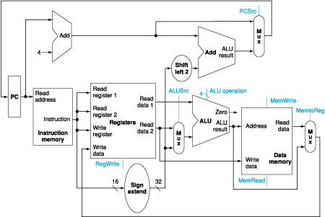
Building the Datapath (for R-Type)
Example: addu $t0, $s1, $s2
31
26
21
16
11
6
0
op
rs
rt
rd
shamt
funct
6 bits
5 bits
5 bits
5 bits
5 bits
6 bits
Fetch Instruction
Read Two Registers
ALU Operation
Write Register

Slide 4
Building the Datapath (for Immediate)
Example: addi $t0, $s1, 100
31
26
21
16
0
op
rs
rt
immediate
6 bits
5 bits
5 bits
16 bits
Fetch Instruction
Read One Register
Signed extend immediate
Calculation Result
Read Data from Memory
Write Register

Slide 5
Building the Datapath (for Load/Store)
Example lw $s1, offset($s0)
31
26
21
16
0
op
rs
rt
immediate
6 bits
5 bits
5 bits
16 bits
Fetch Instruction
Read One Register ($s0)
Signed extend immediate (offset)
Calculation Address
Read Data from Memory
Write Register ($s1)

Slide 6
Building the Datapath (Branch function)
Example: beq, $t1, $t2, offset
31
26
21
16
0
op
rs
rt
immediate
6 bits
5 bits
5 bits
16 bits
Fetch Instruction
Read Two Registers
ALU Operations
ALU 1 perform Subtraction
ALU 2 calculate PC+4+Offset
ALU Zero decide the next PC value

Slide 7
Review: The MIPS Instruction Formats
All MIPS instructions are 32 bits long. 3 formats:
R-type
I-type
J-type
The different fields are:
op: operation (“opcode”) of the instruction
rs, rt, rd: the source and destination register specifiers
shamt: shift amount
funct: selects the variant of the operation in the “op” field
address / immediate: address offset or immediate value
target address: target address of jump instruction
31
26
21
16
11
6
0
op
rs
rt
rd
shamt
funct
6 bits
5 bits
5 bits
5 bits
5 bits
6 bits
31
26
21
16
0
op
rs
rt
address/immediate
6 bits
5 bits
5 bits
16 bits
31
26
0
op
target address
6 bits
26 bits
Notes:
One of the most important thing you need to know before you start designing a processor is how the instructions look like.
Or in more technical term, you need to know the instruction format. One good thing about the MIPS instruction set is that it is very simple.
First of all, all MIPS instructions are 32 bits long and there are only three instruction formats: (a) R-type, (b) I-type, and (c) J-type.
The different fields of the R-type instructions are:
(a) OP specifies the operation of the instruction.
(b) Rs, Rt, and Rd are the source and destination register specifiers.
(c) Shamt specifies the amount you need to shift for the shift instructions.
(d) Funct selects the variant of the operation specified in the “op” field.
For the I-type instruction, bits 0 to 15 are used as an immediate field. I will show you how this immediate field is used differently by different instructions.
Finally for the J-type instruction, bits 0 to 25 become the target address of the jump.
+3 = 10 min. (X:50)

Slide 8
Control Signal
Selecting the operations to perform (ALU, read/write, etc.)
Controlling the flow of data (multiplexor inputs)
Information comes from the 32 bits of the instruction
Example: add $t0, $s1, $s2 Instruction Format: 000000 10001 10010 01000 00000 100000 op rs rt rd shamt funct
ALU's operation based on instruction type and function code

Slide 9
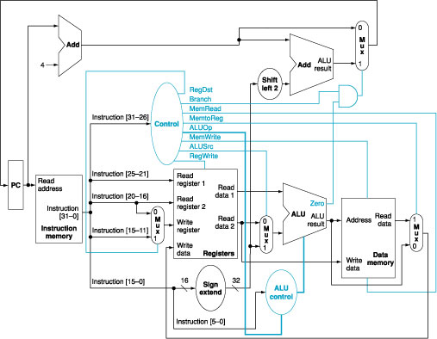
The Simple Datapath with Control Unit
Control Unit Output
Branch
MemRead
MemtoReg
ALUOp
MemWrite
ALUSrc
RegWrite

Slide 10
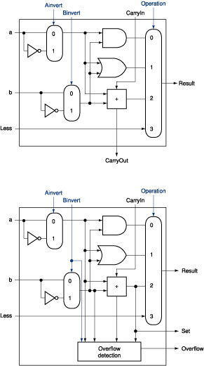
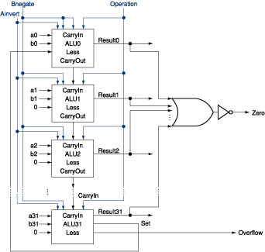
Review: The ALU Diagram
ALU control lines: 0000 = and 0001 = or 0010 = add 0110 = subtract 0111 = slt 1100 = NOR
ALU 0~30
ALU 31

Slide 11
ALU Control
ALU used for
Load/Store: F = add
Branch: F = subtract
R-type: F depends on funct field
ALU control | Function
0000 | AND
0001 | OR
0010 | add
0110 | subtract
0111 | set-on-less-than
1100 | NOR

Slide 12
ALU Control
Assume 2-bit ALUOp derived from opcode
Combinational logic derives ALU control
opcode | ALUOp | Operation | funct | ALU function | ALU control
lw | 00 | load word | XXXXXX | add | 0010
sw | 00 | store word | XXXXXX | add | 0010
beq | 01 | branch equal | XXXXXX | subtract | 0110
R-type | 10 | add | 100000 | add | 0010
 |  | subtract | 100010 | subtract | 0110
 |  | AND | 100100 | AND | 0000
 |  | OR | 100101 | OR | 0001
 |  | set-on-less-than | 101010 | set-on-less-than | 0111

Slide 13
ALU Control Signal Generation (1/2)
What should the ALU do with this instruction
Example: lw $1, 100($2) 35 2 1 100 op rs rt 16 bit offset
ALU control input 0000 AND 0001 OR 0010 add 0110 subtract 0111 set-on-less-than 1100 NOR

Slide 14
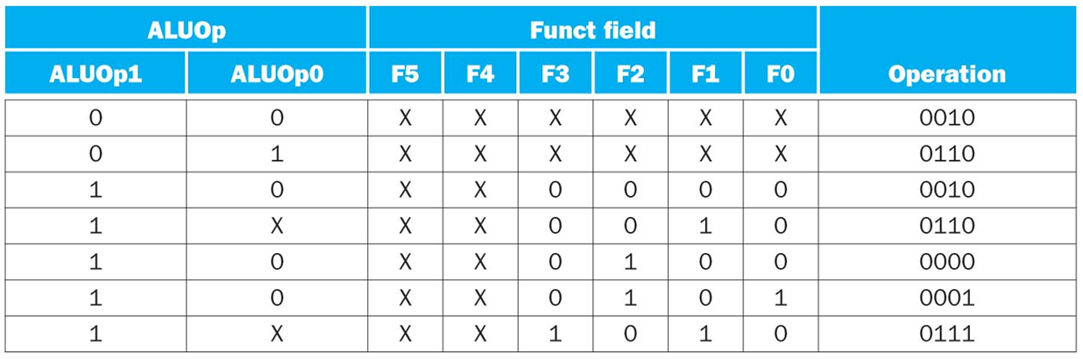
ALU Control Signal Generation (2/2)
Must describe hardware to compute 4-bit ALU control input
given instruction type 00 = lw, sw 01 = beq, 10 = arithmetic
function code for arithmetic
Describe it using a truth table (can turn into gates):
ALUOp computed from instruction type

Slide 15
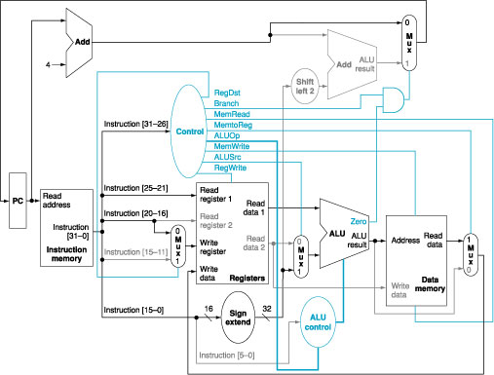
How do the Datapath Implement a Beq Function?
1
0
0
0
X
0110
X
0
01

Slide 16
How do the Processor Implement a beq Function (beq $t1, $t2, L)?
1
0
0
0
X
0110
X
0
01

Slide 17
How do the Processor Implement an addu Function (addu $t1, $t2, $t3)?
0
1
0
0
0
1
0010
0

Slide 18
How do the Processor Implement an sw Function (sw $t1 100($t2))?
0
0
1
1
X
X
0010
0

Slide 19
Single Processor Control Signal Summary

Slide 20
Review: J-Format Instructions (1/2)
Define “fields” of the following number of bits each:
6 bits
26 bits
As usual, each field has a name:
opcode
target address
Key Concepts
Keep opcode field identical to R-format and I-format for consistency.
Combine all other fields to make room for large target address.

